Slide 1




Engage-2022
Facial
Recognition
Smart Attendance Tracking.
Managing Student records.
Sending e-mails.
web-application
Name : Anuridhi Chhangani
E-mail: 20051453@kiit.ac.in

Slide 2


PROBLEM :
Engage-2022
Attendance
tracking
Face recognition technology has been helpful in many aspects. Attendance tracking is its most innovative use for easy access of the presence of each individual.
"
Making
attendance noting
and record managing
easy & handy.
"

Slide 3







Workflow Diagram :
Engage-2022
Teacher
Student
Filters students using a unique id.
Access primary student's info.
Student details & attendance access.
Print statistical record of attendance.
Sending Attendance Report via e-mail.
log in and view all his/her details.
Drop facial attendance using web-cam.
Edit basic info/details if required.
Couldn't edit/modify attendance.
Web-Application
Institute
Admin
Can add new student details.
Edit student details
Fetch student detail
Print out the attendance record
Send mails to the parents/student account.
Admin of the site
DB Admin
Maintain DB
Generate necessary reports
Database

Slide 4





Technology
used
Engage-2022
Front-end :
The user-friendly interface for the students,to login and use.
Back-end :
Database to store student info & attendance
details.
OPENCV

Slide 5
APPROACH :
Engage-2022
Idea :
Front-end :
A student-portal website for the
students to mark attendance by web-cam, check old records and for the authorities to get statistical record & send report via-mail .
Login/Register , students can enter student-id and use web-cam to drop attendance at dashboard , use main details page to view complete records.
Send mail -including report via e-mail.
Back-end :
Database :
Personal student account details, generating id , current academic session, any current fellowship, grants, internships or trainings they are currently a part of.
This helps in keeping track of the students taking admission and leaving college&their attendance.
A student database that will contain students all present and past details,attendance & other informations
We can fetch those details using students' unique id numbers.
Data which has privacy concerns won't be shown to unauthorized persons.

Slide 6

Engage-2022
Facial-Attendance portal would simplify management, categorisation and updating of student records & data. Owing to my unique student id convention we may easily filter out students graduating from a particular batch, belonging to a particular institution or even studying in the same branch.
How
Effective
The website is fully responsive and works across all devices. Since college administration will be responsible for creation of accounts, the platform would be accessible to all students enrolled & teachers under the University.

Slide 7
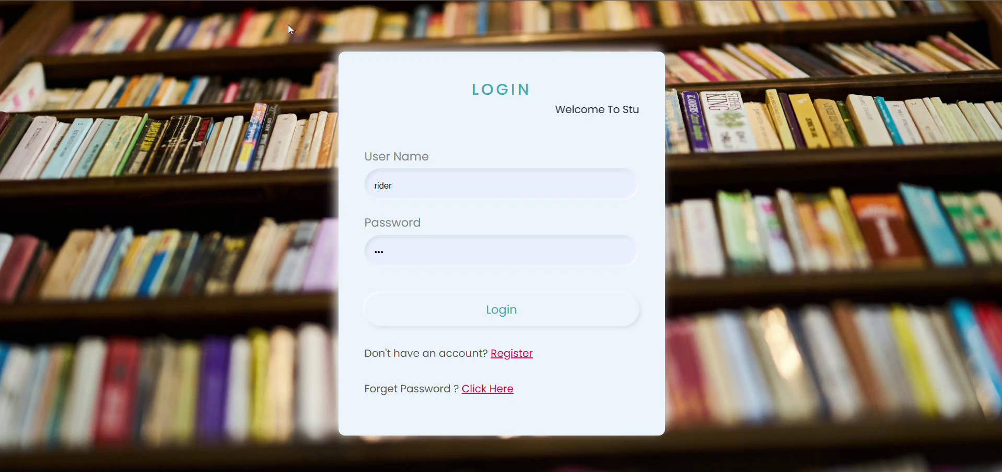
Engage-2022
THANK
YOU!!

